Slide 2
A simple, low interest & flexible loan for ’s smallest businesses & nonprofits

Slide 3
A simple, low interest & flexible loan for ’s smallest businesses & nonprofits
- so you can dream bigger

Slide 4
COVID-19 has been especially hard on Washington’s smallest businesses and nonprofits.

Slide 5
SMALL BUSINESSES & NONPROFITS provide essential goods and services, while creating jobs that contribute to the health of our statewide economy.

Slide 6
OUR COMMUNITIES ARE STRONGER WHEN SMALL BUSINESSES THRIVE

Slide 7
SMALL BUSINESS FLEX FUND is a new resource to help you grow your business

Slide 8
SMALL BUSINESS FLEX FUND is a new resource to help you grow your business
Supported by the Washington State Department of Commerce

Slide 9
SMALL BUSINESS FLEX FUND is a new resource to help you grow your business
Supported by the Washington State Department of Commerce
Designed to help you access funds at a competitive interest rate to bounce back stronger than ever

Slide 10
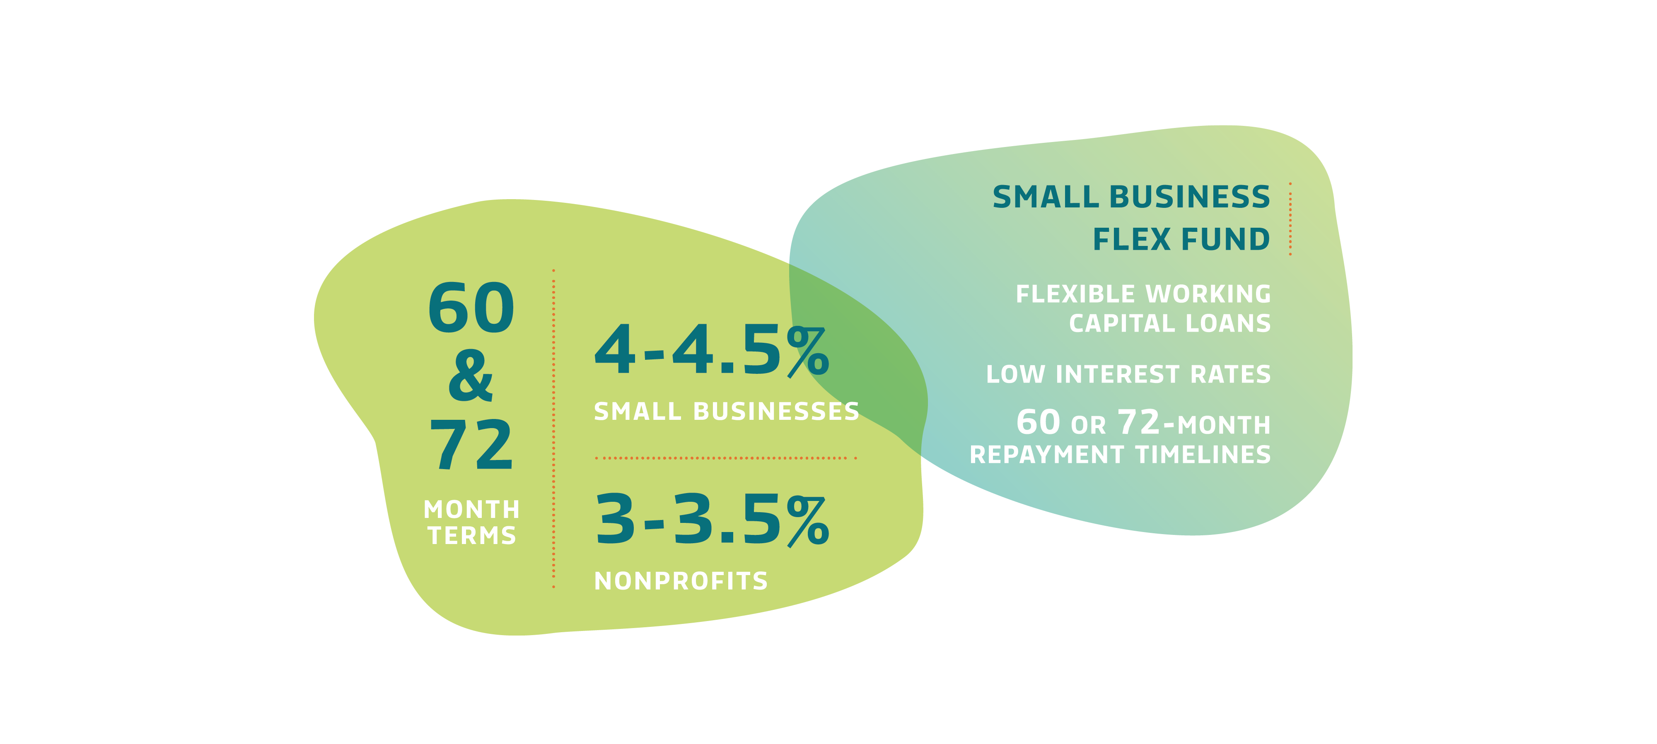
Bounce back stronger than ever

Slide 11
LOW INTEREST RATES
APPLYING IS SIMPLE
LOAN USE IS FLEXIBLE
Borrow up to $150,000
3% - 4.5% Interest rates
No fees & interest-only payments for the first year
60 & 72-month loan terms
72-month loan term only available until 12/31/21
Fewer than 50 employees
Annual revenues of less than $3 million
Experienced direct economic hardship due to COVID-19
Payroll
Utilities & rent
Marketing & advertising
Building improvements or repairs
Other business expenses

Slide 12
LOW INTEREST RATES
APPLYING IS SIMPLE
LOAN USE IS FLEXIBLE
Borrow up to $150,000
3% - 4.5% Interest rates
No fees & interest-only payments for the first year
60 & 72-month loan terms
72-month loan term only available until 12/31/21
Fewer than 50 employees
Annual revenues of less than $3 million
Experienced direct economic hardship due to COVID-19
Payroll
Utilities & rent
Marketing & advertising
Building improvements or repairs
Other business expenses

Slide 13
LOW INTEREST RATES
APPLYING IS SIMPLE
LOAN USE IS FLEXIBLE
Borrow up to $150,000
3% - 4.5% Interest rates
No fees & interest-only payments for the first year
60 & 72-month loan terms
72-month loan term only available until 12/31/21
Fewer than 50 employees
Annual revenues of less than $3 million
Experienced direct economic hardship due to COVID-19
Payroll
Utilities & rent
Marketing & advertising
Building improvements or repairs
Other business expenses

Slide 14
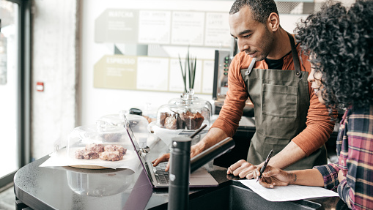
IT’S DIFFERENT FROM OTHER COVID-19 RECOVERY PROGRAMS

Slide 15
It’s local, community lenders COMMITTED TO YOUR SUCCESS

Slide 16
It’s local, community lenders COMMITTED TO YOUR SUCCESS
A network of nonprofit, community-based lenders with decades of experience helping Washington’s small businesses and nonprofits thrive

Slide 17
It’s local, community lenders COMMITTED TO YOUR SUCCESS
A network of nonprofit, community-based lenders with decades of experience helping Washington’s small businesses and nonprofits thrive
These community lenders can assist with the application and make connections to business support services in your community

Slide 18
It’s local, community lenders COMMITTED TO YOUR SUCCESS
SMALL BUSINESS FLEX FUND is not associated with the federal Paycheck Protection Program (PPP) or any other SBA program.

Slide 19
It’s local, community lenders COMMITTED TO YOUR SUCCESS
SMALL BUSINESS FLEX FUND is not associated with the federal Paycheck Protection Program (PPP) or any other SBA program.
The borrower will need to pay back the full amount of the loan with interest over a 5 or 6-year term.

Slide 20
It’s local, community lenders COMMITTED TO YOUR SUCCESS
SMALL BUSINESS FLEX FUND is not associated with the federal Paycheck Protection Program (PPP) or any other SBA program.
The borrower will need to pay back the full amount of the loan with interest over a 5 or 6-year term.
It is NOT a forgivable loan.

Slide 21
SmallBusinessFlexFund.org

